Slide 1
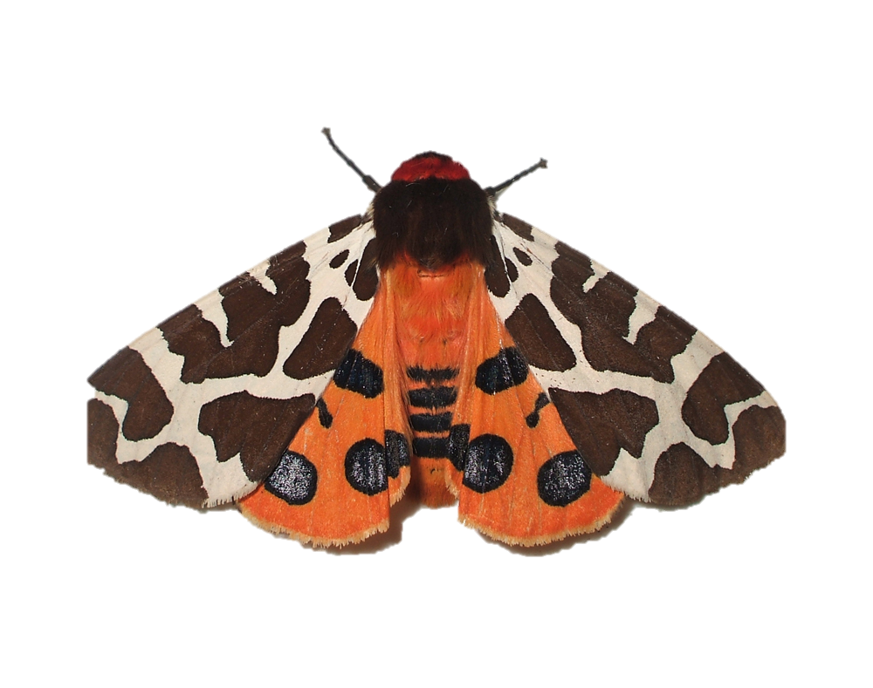
Insects in decline
Student sheet A
Information cards
The life cycle of the garden tiger moth
Plants need certain things to live and grow.
These include air, water, light, warmth and nutrients.
Plants die if they don’t get all of these.
Adult lays eggs on leaves
Adult moths emerge
Caterpillars hatch and grow
Caterpillars make a simple cocoon
The temperature in the UK is increasing.
This is making droughts more common.
Droughts happen when there is not enough rain.
Garden tiger moth caterpillars eat the leaves of many different species of plant including stinging nettle, dock, burdocks, plantain, comfrey and dandelions.
The adult moths feed on nectar from flowers.
Notes:
The cards can be cut out in advance for the class, or more simply give groups the sheet as it is.

Slide 2
Insects in decline
Student sheet B
Fill in the boxes 1
Temperature rises
Decrease in moths
Temperature rises
Decrease in moths
Notes:
Harder version (more suitable for year 6 students).

Slide 3
Insects in decline
Student sheet C
Fill in the boxes 2
More d……….. happen.
There is less r………
Plants have less w……...
They die.
Caterpillars and moths have less f…….
Temperature rises
Decrease in moths
More d……….. happen.
There is less r………
Plants have less w……...
They die.
Caterpillars and moths have less f…….
Temperature rises
Decrease in moths
Notes:
Easier version (more suitable for year 4 students)

